Slide 1
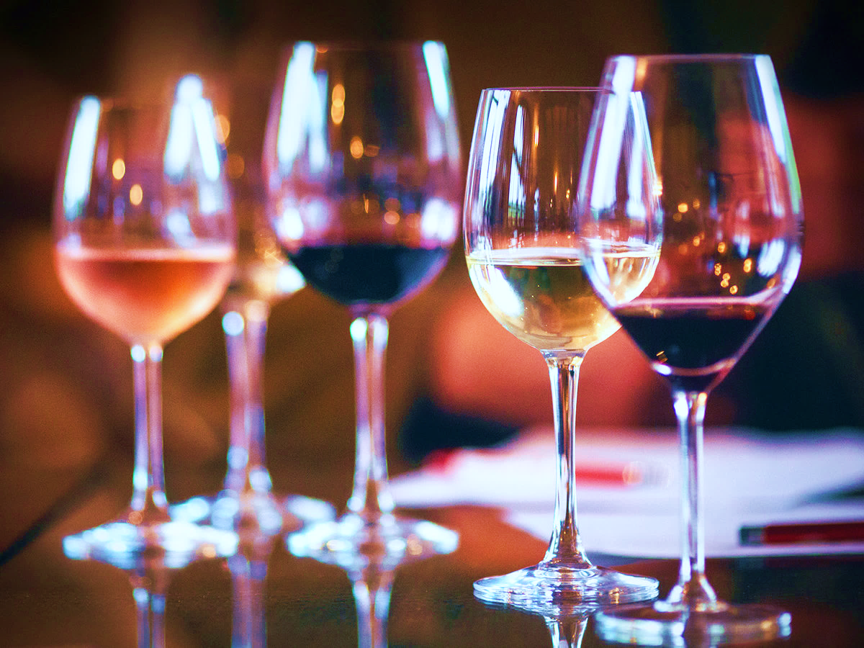
We invite you to a
Wine tasting
Spanish wines
September 7th @ 7pm
Canteen at GFI
Price: 200 NOK

Slide 2
Wine tasting
A tour around Spain
September 7th, 2018

Slide 3
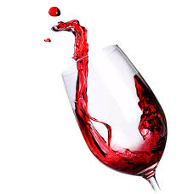
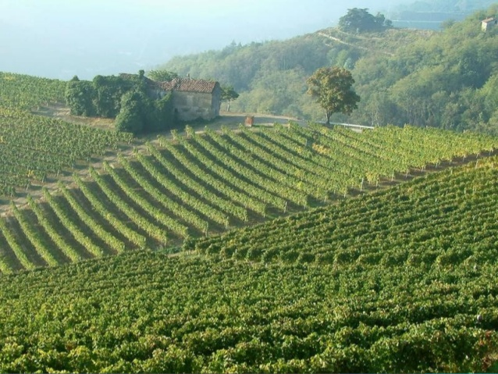
What is wine?
Grape juice + yeast = alcohol & CO2

Slide 4
Today: a small tour around Spain
We will taste wines from 5 regions of Spain
This presentation will introduce you to the wines in Spain and help you with tasting techniques

Slide 5
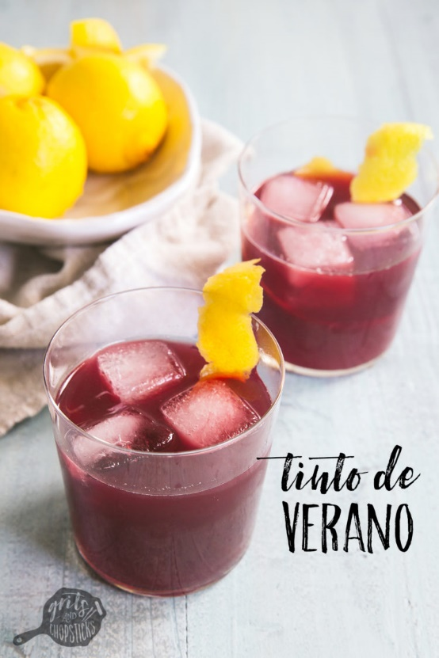
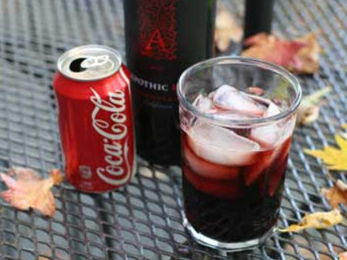
Famous wines of Spain
sangria, kalimotxo and tinto de verano

Slide 6
Facts about Spanish wine
Spain has the largest extension of vineyards in the world (950.000 hectares).
It is 3rd largest in terms of world-wide wine production (behind France (1st) and Italy (2nd)).
About 2/3 of all wines produced in Spain are table wines with about 1/3 comprising high-quality wines.
World leader in wine export volume (2.2 million litters in 2016).
The Spanish cava is the 2nd best selling sparkling wine in the world (over the French ones).
The best sommelier and the best oenologist in the world are Spanish.
Spanish wine was the Romans' favourite tipple.
There are over 400 grape varieties in Spain.
Spain is the number one worldwide producer of organic wine.

Slide 7
Wine in Spain
Spain’s wine heritage is at least 3,000 years old:
Vineyards in Sherry region (Andalusia) were planted by the Phoenicians around 1,100 BC.
Wines from the Mediterranean and Atlantic coasts were traded and consumed by the Romans.
Spain's principal rivers are at the heart of many Spanish wine regions:
Ebro river that runs through the Rioja and several Catalan wine regions.
Duero river flows westward through the Ribera del Duero region in Spain before crossing the border into Portugal's Douro Valley which is at the heart of Port wine production.
Tajo river runs through the La Mancha region.
Guadalquivir river flows into the Atlantic at the Sherry producing region.

Slide 8
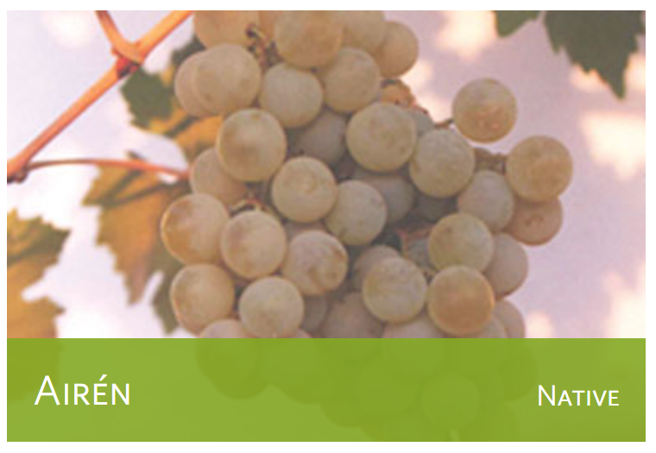
Grapes in Spain
Abundance of native grape varieties, with over 400 varieties though 80% of the country's wine production is from only 20 grape varieties:
Reds: Tempranillo, Garnacha, and Monastrell;
Whites: Albariño, Palomino, Airén, and Macabeo;
Cava grapes: Parellada, Xarel·lo, and Macabeo.
The most widely planted is Airén, a white wine grape which is valued for a variety of reasons including its hardiness. Second is Tempranillo, the popular grape of Rioja, followed closely by Garnacha which is planted throughout Spain but mostly known internationally due to the Catalan region of Priorat.

Slide 9
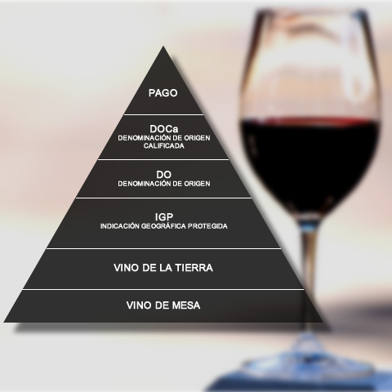
Spanish wine classification & terms
The top of the Spanish wine quality pyramid is Denominación de Origen Calificada (Rioja and Priorat). Spain also has a unique category, called DO Pago, which is for individual single-estates with an international reputation.

Slide 10
Spanish wine classification & terms
Spanish wines are often labelled according to the amount of aging the wine has received:
Vino joven ("young wine"): very little, if any, wood aging.
Crianza:
Red wines: aged for 2 years with at least 6 months in oak.
Whites and rosés: aged for at least 1 year with at least 6 months in oak.
Reserva:
Red wines: aged for at least 3 years with at least 1 year in oak.
Whites and rosés: aged for at least 2 years with at least 6 months in oak.
Gran Reserva:
Red wines: at least 5 years aging, 18 months of which in oak and a minimum of 36 months in the bottle.
Whites and rosés: aged for at least 4 years with at least 6 months in oak.

Slide 11
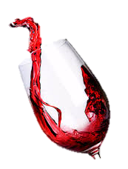
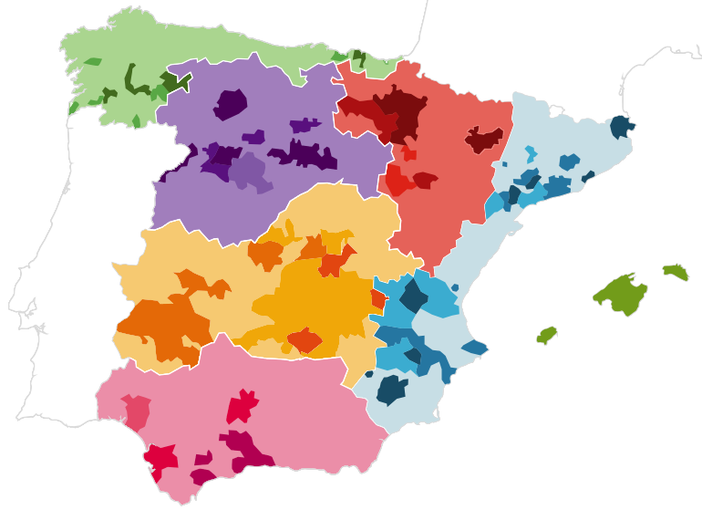
Where are we going today?
La rioja
Castilla y león
Navarra
Galicia
Valencia

Slide 12
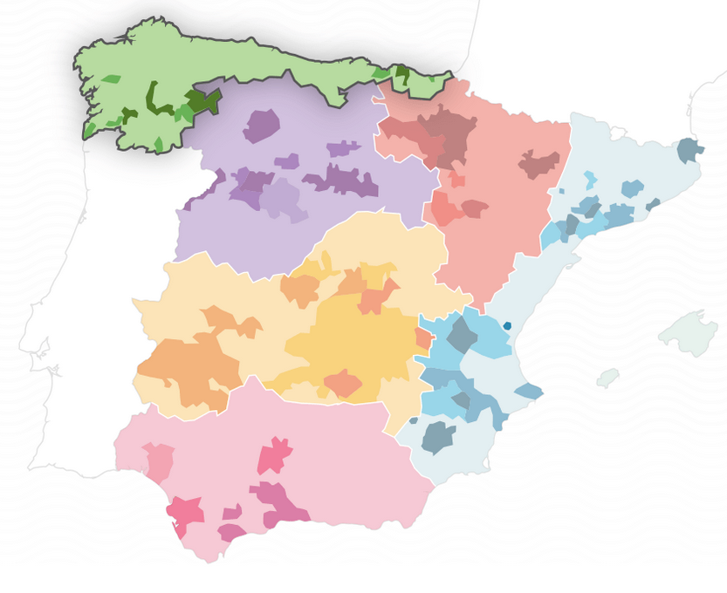
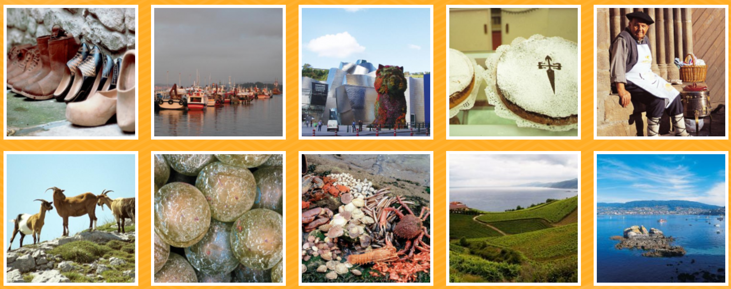
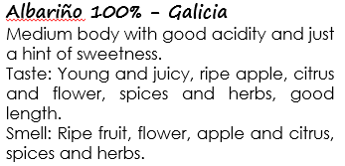
Green Spain (Galicia)
Very unlike the rest of Spain, the northwest is where lush green valleys are plentiful and cool and misty climate necessitates a focus upon earlier-ripening grapes.
The area specializes in zesty white wines and a few aromatic red wines made with Mencía.
Albariño is the champion grape of the sub-region called Rias Baixas, which skirts the coast.

Slide 13
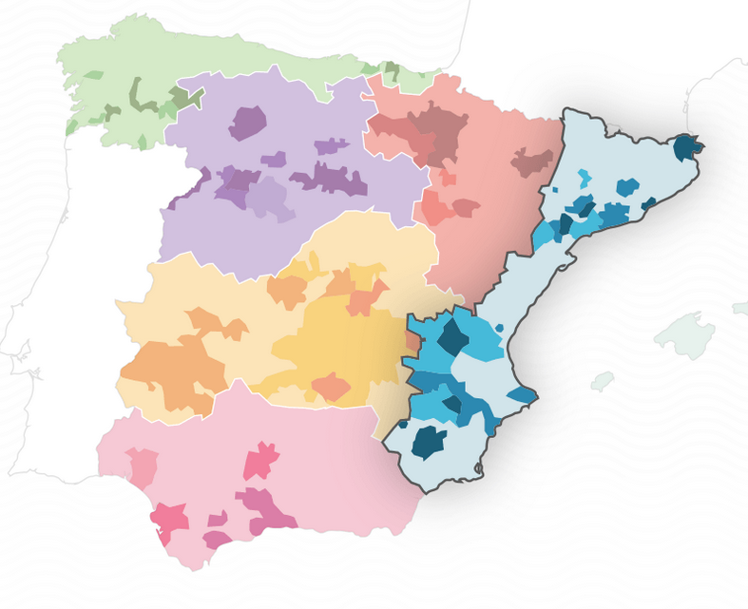
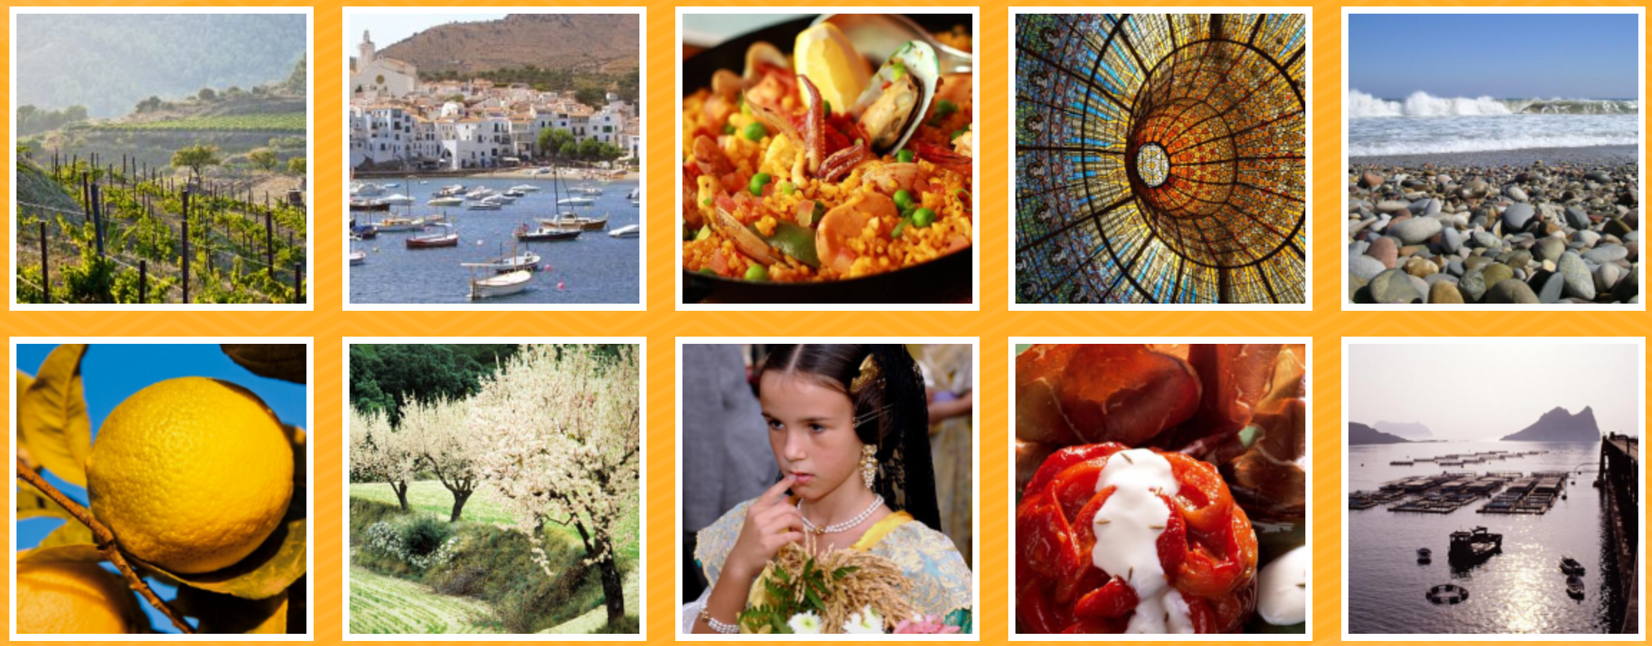
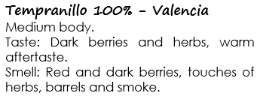
Mediterranean Coast (Valencia)
White wines prosper in a number of sites along the Mediterranean, though not as frequently as the reds.
Garnacha is far more planted than is Tempranillo. Syrah and Bordeaux varieties show up in more elevated and protected sites.
Catalonia is known for Cava (Spanish sparkling wine) and a highly acclaimed red wine subzone, Priorat. Valencia and Murcia are warmer growing regions that produce a bulk of value wines from deep red Monastrell to aromatic white Malvasia and the widely planted Airén.

Slide 14
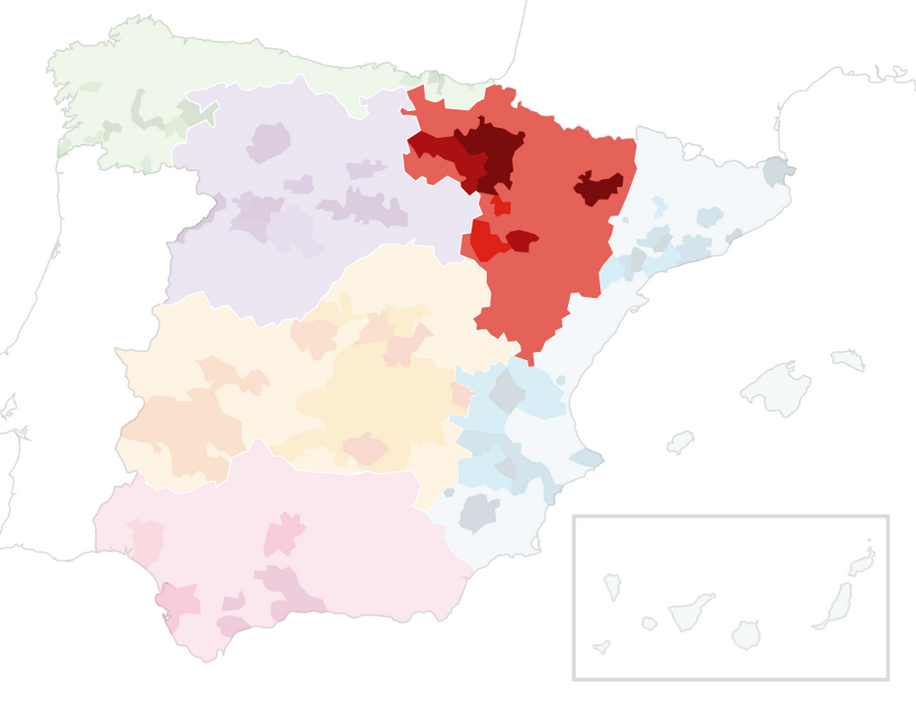
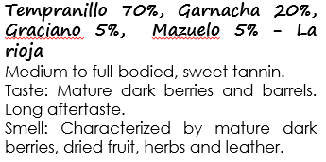
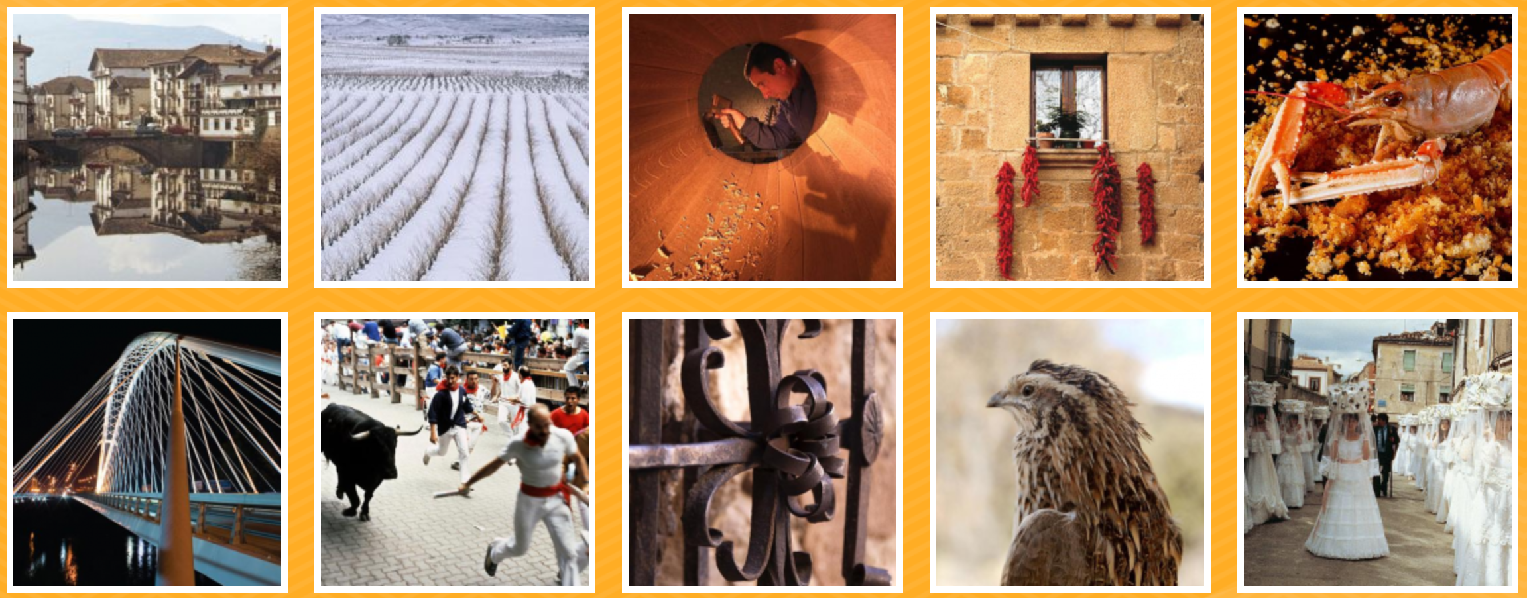
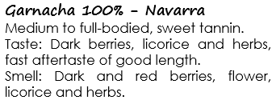
Ebro River Valley (La rioja and Navarra)
The sub-regions of La rioja and Navarra are found in the Ebro River Valley.
La rioja is known for red wine, Rioja.
Navarra is known mostly for rosé wine made with Garnacha and oak-aged white wines.
Tempranillo is king, certainly, but Garnacha, Mazuelo, and Graciano are emerging.

Slide 15
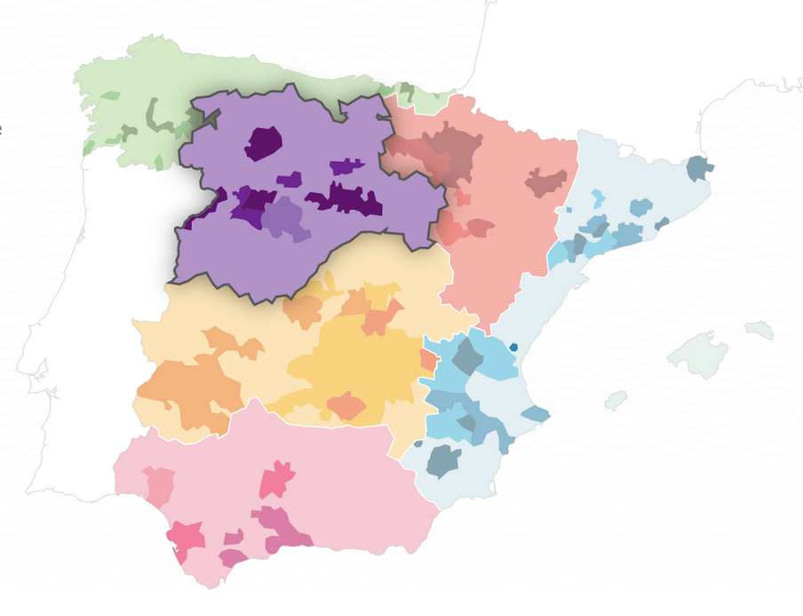
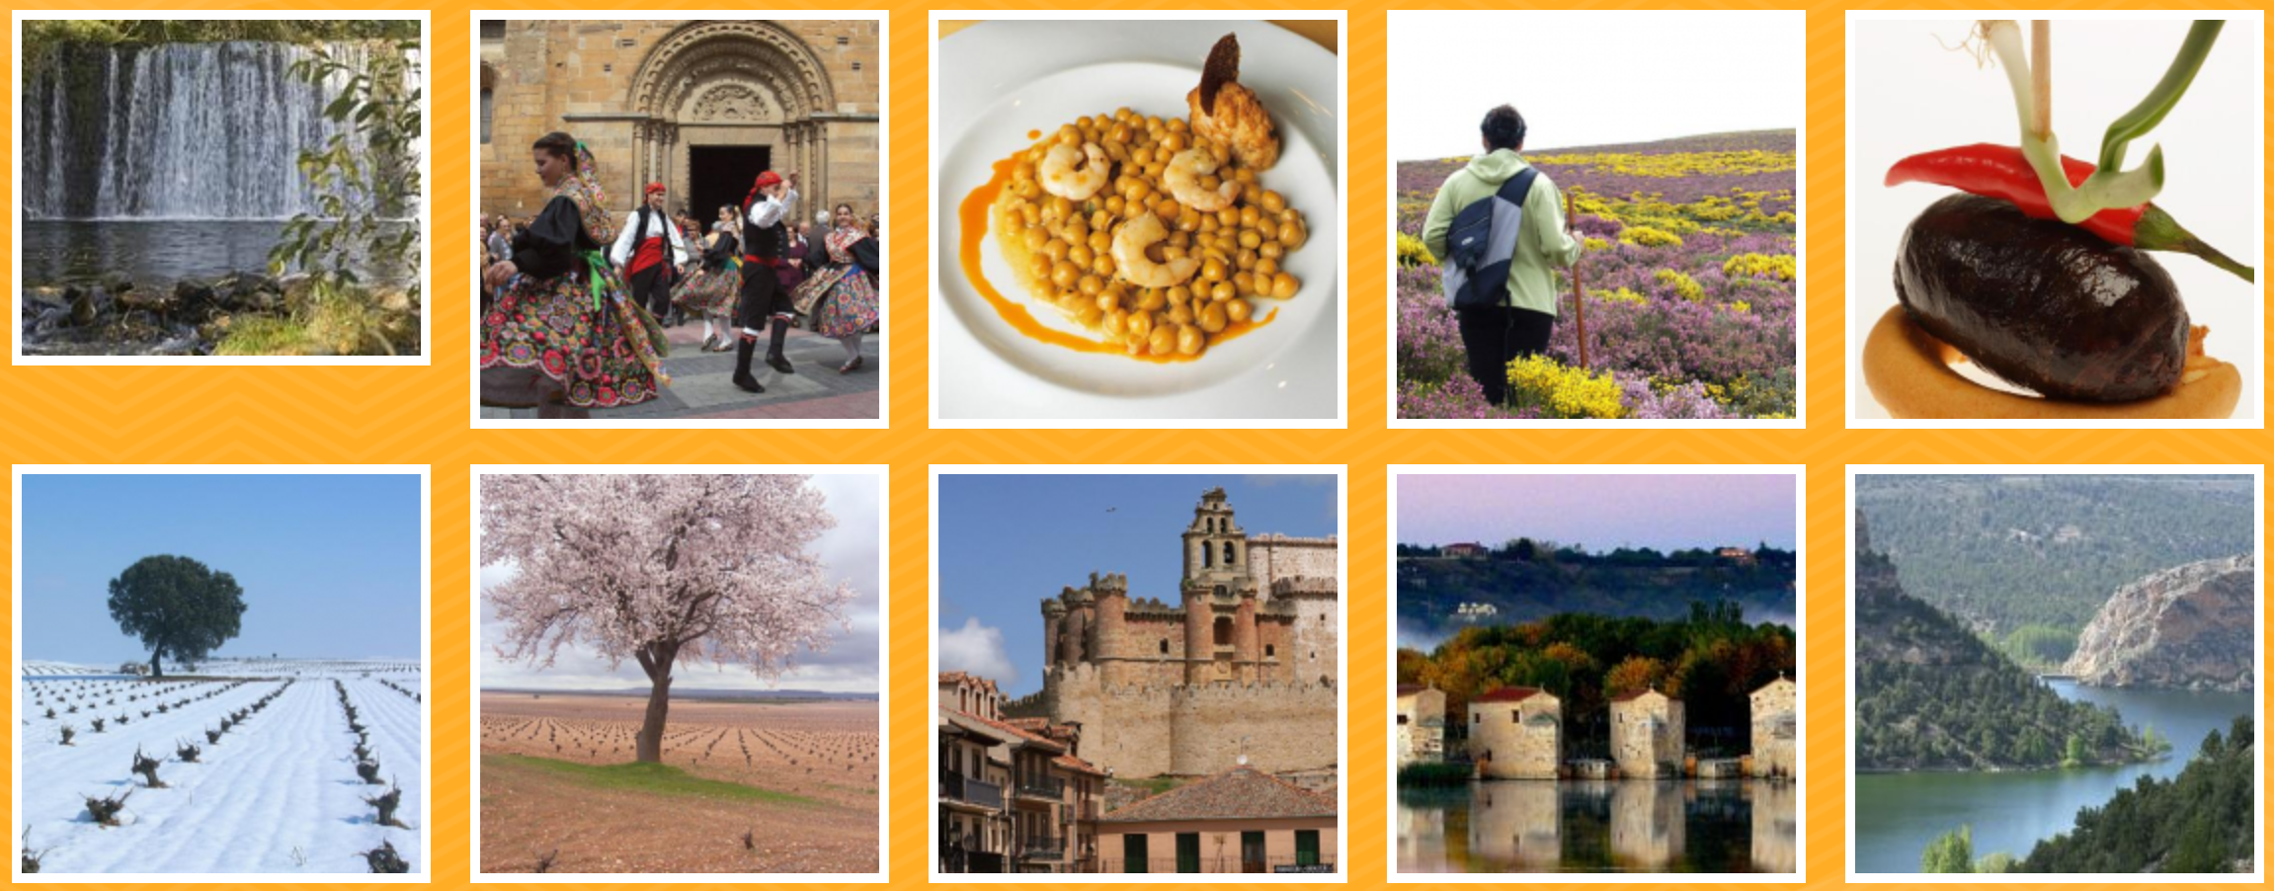
Duero river region (Castilla y León)
The wine grape of this region is Tempranillo and in Toro it’s called Tinta de Toro, where it is considered to be a slight mutation of the Tempranillo grape.
Ribera del Duero is home to one of the most famous wineries in Spain: Vega Sicilia.
In this high elevation viticulture, days are hot; nights are cold. Ripening is slowed; the wines become rich and ripe but hang on to their dusty, astringent structure.

Slide 16
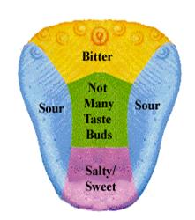
Basics of tasting

Slide 17
What to look for in red wine
To determine the age, tilt your glass over a white surface and look at the color of the wine:
Purple/red means younger wine,
Brick/tawny means an older wine (more oxidation).
To determine the body (viscosity), swirl the glass and then straighten it upright. Watch how rapid the wine drops: the higher alcohol and/or sugar content makes the slower the wine drops.
Smell the wine: Fruitiness (red berries, black berries), Flower (floral, spice, buttery, leather), Earth (stone, chalk, dusty, wet earth, barnyard), Wood (new, old).
Taste the wine:
Sweetness hits your tongue first: dry, off-dry, sweet, very sweet.
Acidity is the first impact on the tongue: refreshing, crisp, balance.
Tannin (low/medium/high): almost the last flavor tasted and sensed in the back of the mouth and throat.
Alcohol (low/medium/high): the final note is that of alcohol.

Slide 18
The color of wine

Slide 19
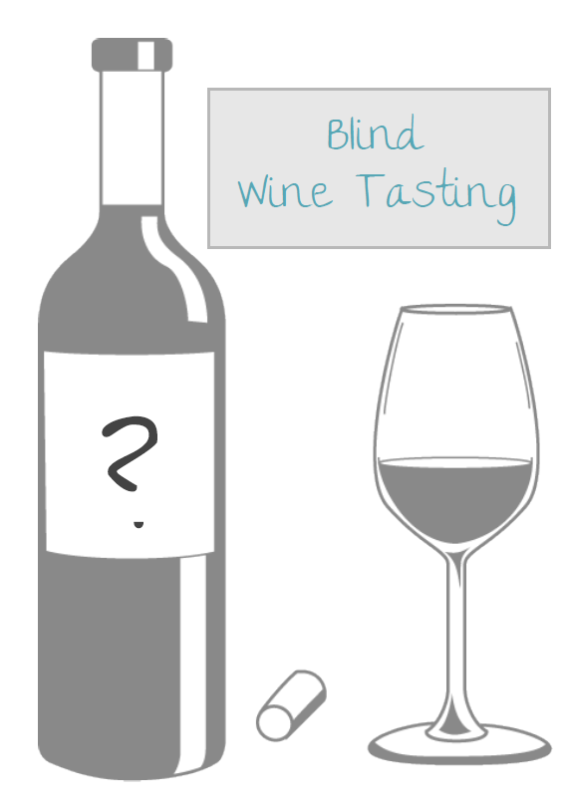
Wine characteristics
Body
This refers to the perceived “weight” and viscosity of the wine. A full-bodied wine feels thick, coating the sides of the glass as you swirl. A light-bodied wine is almost like water. A medium-bodied wine is somewhere in-between.
Sweetness
Needs no explanation. The opposite of sweet is dry. A wine can also be medium-dry or off-dry (i.e. just a hint of sweetness, but almost too faint to move the needle).
Acidity
Acidity in wine is tart and zesty. Acidity is a big deal for white wines; it makes them refreshing and crisp. Acidic wines give you a tingling sensation that focuses on the front and sides of your tongue.
Tannin
It is all about the tannins for red wine. High tannin wines are astringent and will leave a lingering bitter/dry feeling in your mouth. Lower tannin wines are smooth and soft.
Blind
Wine Tasting

Slide 20
Albariño 100% - Galicia
Medium body with good acidity and just a hint of sweetness.
Taste: Young and juicy, ripe apple, citrus and flower, spices and herbs, good length.
Smell: Ripe fruit, flower, apple and citrus, spices and herbs.
Tempranillo 70%, Garnacha 20%, Graciano 5%, Mazuelo 5% - La rioja
Medium to full-bodied, sweet tannin.
Taste: Mature dark berries and barrels. Long aftertaste.
Smell: Characterized by mature dark berries, dried fruit, herbs and leather.
Garnacha 100% - Navarra
Medium to full-bodied, sweet tannin.
Taste: Dark berries, licorice and herbs, fast aftertaste of good length.
Smell: Dark and red berries, flower, licorice and herbs.
Tempranillo 100% - Valencia
Medium body.
Taste: Dark berries and herbs, warm aftertaste.
Smell: Red and dark berries, touches of herbs, barrels and smoke.
Garnacha 100% - Castilla y León
Medium to full body.
Taste: Ripe red berries, green herbs and a little flower, good length.
Smell: Red berries, herbs and flower.
Wine #1
Body:
Full / Medium / Light
Sweetness:
Sweet / Off-Dry / Dry
Impressions:
Score (1-10):
Guess:
Wine #2
Body:
Full / Medium / Light
Sweetness:
Sweet / Off-Dry / Dry
Impressions:
Score (1-10):
Guess:
Wine #3
Body:
Full / Medium / Light
Sweetness:
Sweet / Off-Dry / Dry
Impressions:
Score (1-10):
Guess:
Wine #4
Body:
Full / Medium / Light
Sweetness:
Sweet / Off-Dry / Dry
Impressions:
Score (1-10):
Guess:
Wine #5
Body:
Full / Medium / Light
Sweetness:
Sweet / Off-Dry / Dry
Impressions:
Score (1-10):
Guess:

Slide 21
Lets start!

Slide 22
Wine prices
Wine 1: Gauda Abadia de San Campio Albariño 159,90 (Galicia)
Wine 2: Villa Negra Gran Reserva 116,90 (Valencia)
Wine 3: Càtulo Tinto Garnacha 124,90 (Navarra)
Wine 4: Gaznata Viñas Viejas 147,60 (Castilla y León)
Wine 5: Muga Reserva 249.90 (La rioja)

